Slide 1
Leaving Certificate 2021
Written Examinations and Accredited Grades

Slide 2
Candidate Self-Service Portal (CSSP)
https://www.examinations.ie/candidate-portal/
Wed 10th March @ 12:00p.m. -
Tues 16th March @ 6:00p.m.
Re-opens again End April / May 2021
Very important time - decisions of Subject Levels

Slide 3
Candidate Self-Service Portal (CSSP)
To register you will need:
Personal Details
Exam Number
PPSN Number ( first 4 digits )
Email you check regularly
Mobile Number

Slide 4
Candidate Self-Service Portal (CSSP)
Check your Personal Details
Register for Subjects
Add New Subjects / Withdraw from Subjects
Confirm Levels
OPT IN for Leaving Certificate Written Examinations
This is only opportunity to opt for written exams – cannot opt in April or May
OPT IN for SEC Accredited Grades
OPT IN for BOTH Written Examinations AND Accredited Grades

Slide 5
If a student opts to sit the Leaving Certificate examinations (inclusive of SEC marked additional assessment components, where applicable) and not to receive any SEC Accredited Grades, then s/he will receive Leaving Certificate results/grades in the usual manner.
If a student opts only to receive SEC Accredited Grades and not to sit any Leaving Certificate examinations (inclusive of SEC marked additional assessment components), then s/he will receive only SEC Accredited Grades.
If a student opts to sit the Leaving Certificate examination (inclusive of SEC marked additional assessment components) in one or more subjects and also to receive SEC Accredited Grades in one or more subjects, then s/he will receive the best combination of the Leaving Certificate grades and SEC Accredited Grades achieved.

Slide 6
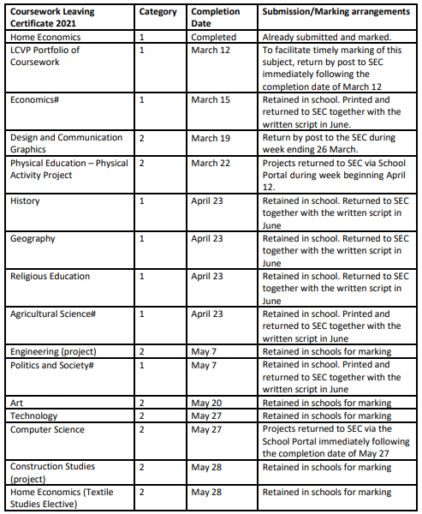
Circular Letter S07/21
3rd March 2021

Slide 7
Subject Levels Careful Consideration Now Given Re-visited End of April / May
Leaving Certificate Written Exams
Candidates opting to sit the examinations will be permitted to change their levels in respect of the written examinations on the day of the examination, as they are in a normal year.
SEC Accredited Grades
The level selected by candidates at the end of April/early May will be an absolutely final decision when it comes to the level – Higher, Ordinary or Foundation – in which they will receive their accredited grade in each subject.
Candidates (or schools) will not be permitted to change levels for the purpose of the accredited grades process after that time.

Slide 8
Course Work and SEC Accredited Grades
In reaching their estimate in subjects with more than one component, teachers will have regard to the written examination and the additional component. The estimation will also take in to consideration the appropriate weightings for all of the components.
Teachers will be asked to formally record their consideration of each component part.
Pg. 12 A Guide to State Examinations and Accredited Grades for Leaving Certificate 2021
Table of directions and dates in pg 3 S07/21 (Slide 6)

Slide 9
Orals and Music Practicals - Easter
Language Orals
In school Teacher
Recorded
Sent to SEC for grading
Music Practical – 2nd Week
SEC appointed examiner
Recorded
Sent to SEC to include in final marking

Slide 10
Candidate Self-Service Portal (CSSP)
https://www.examinations.ie/candidate-portal/
Wed 10th March @ 12:00p.m. -
Tues 16th March @ 6:00p.m.
This 1 week window is only opportunity to opt for written exams – cannot opt in April or May

Slide 11
